Slide 1

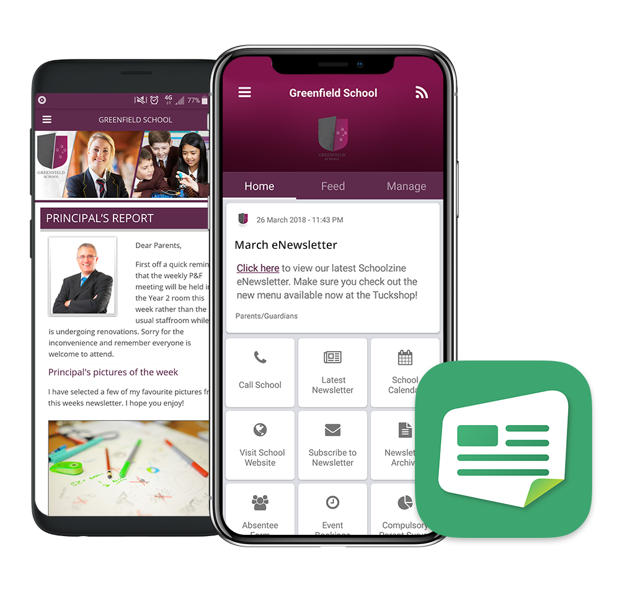



Download our (School Name)
Schoolzine App
SZapp is a great way to keep up to date with our latest news
and information. Using SZapp will give you easy access to
information such as:
  Newsletters on the go
  Latest News & Reminders
  Calendar
  Policies and Documents
  Event Bookings
  Digital Forms

Slide 2


Installing SZapp
Apple devices:
On your device, open the App Store.
Search the App Store for SZapp.
Download and install SZapp.
Android devices:
On your device, open the Play Store.
Search the Play Store for SZapp.
Download and install SZapp.

Slide 3
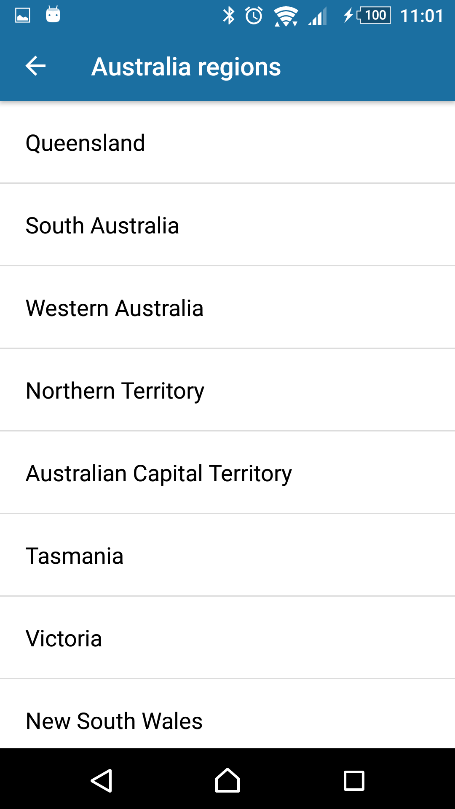
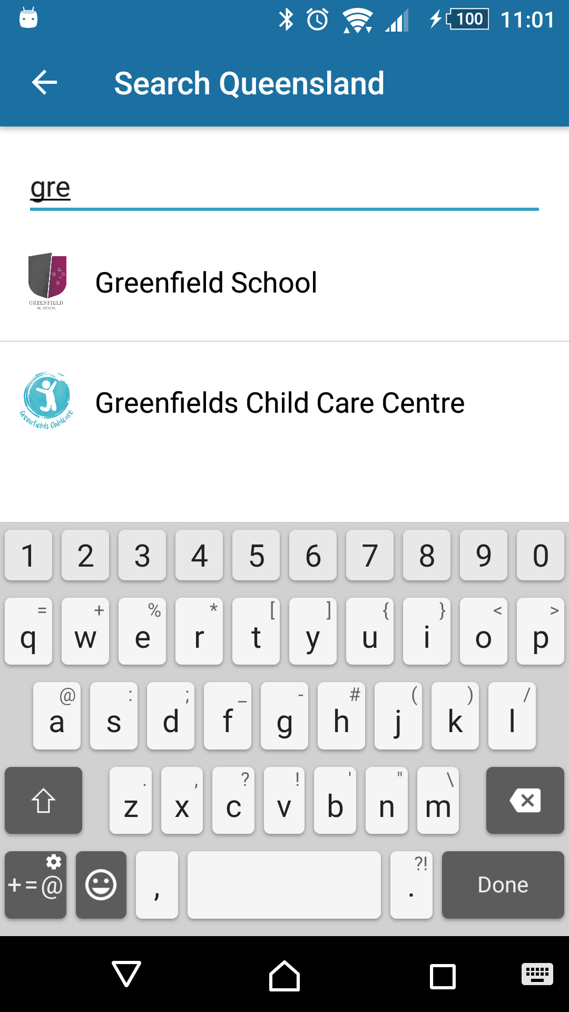
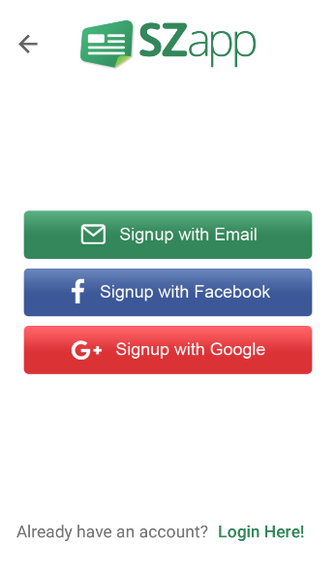
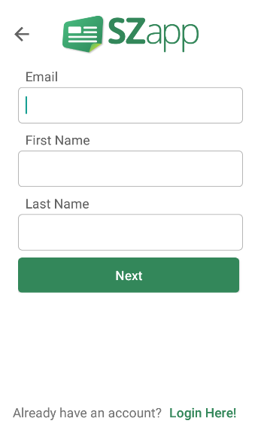
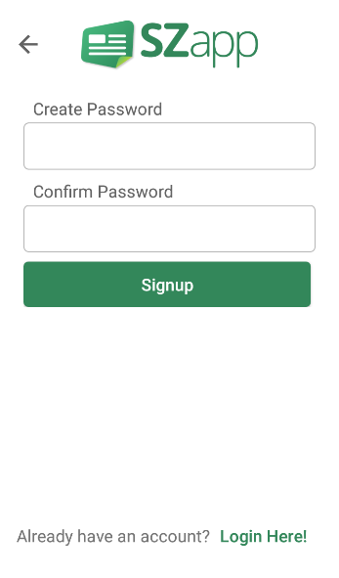
FIND YOUR SCHOOL
Select the region
Search for (insert school name here)
REGISTER A USER
Before you can add your school, you will need to register. Register
with your email or sign in with Google or Facebook.
Enter your email and name and then create a password.

Slide 4
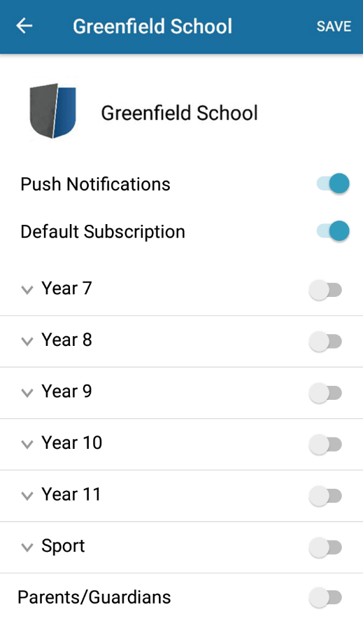
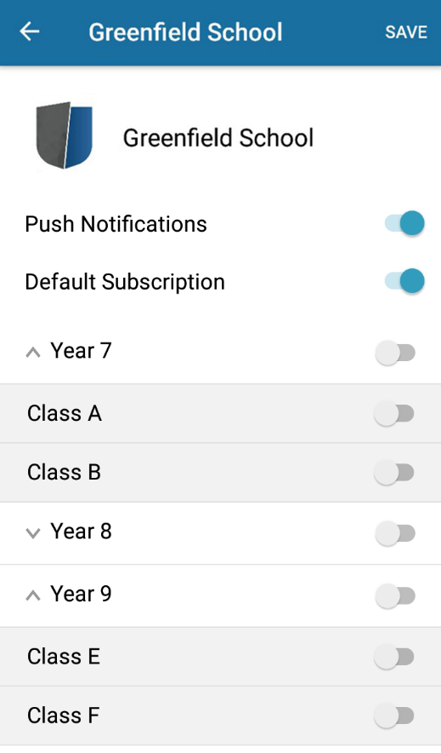
MANAGING NOTIFICATIONS
Choose which group/s you would like to receive
notifications from.
Groups with arrows indicate that there are
sub-groups which you can join.

Slide 5
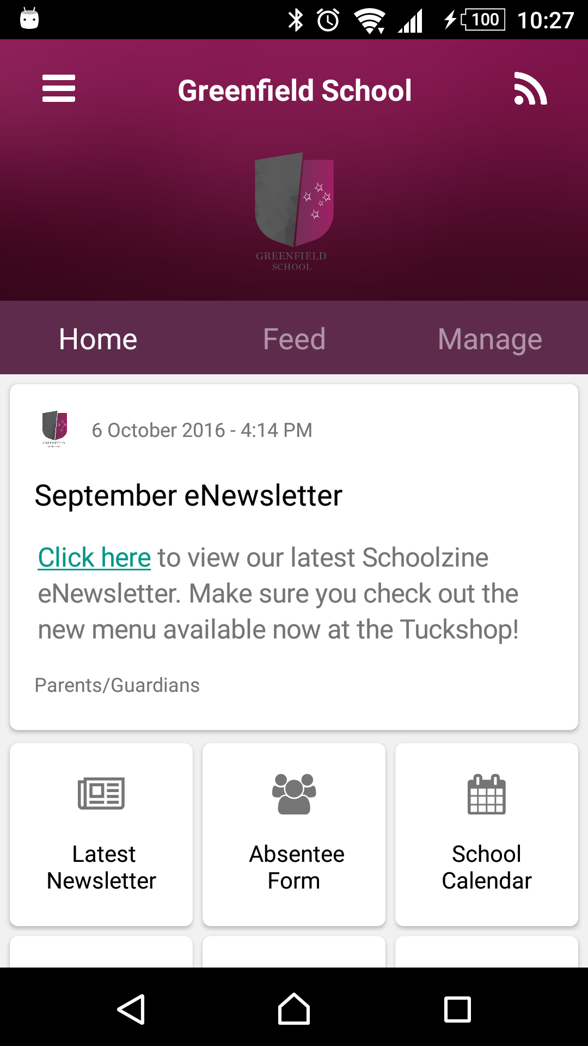
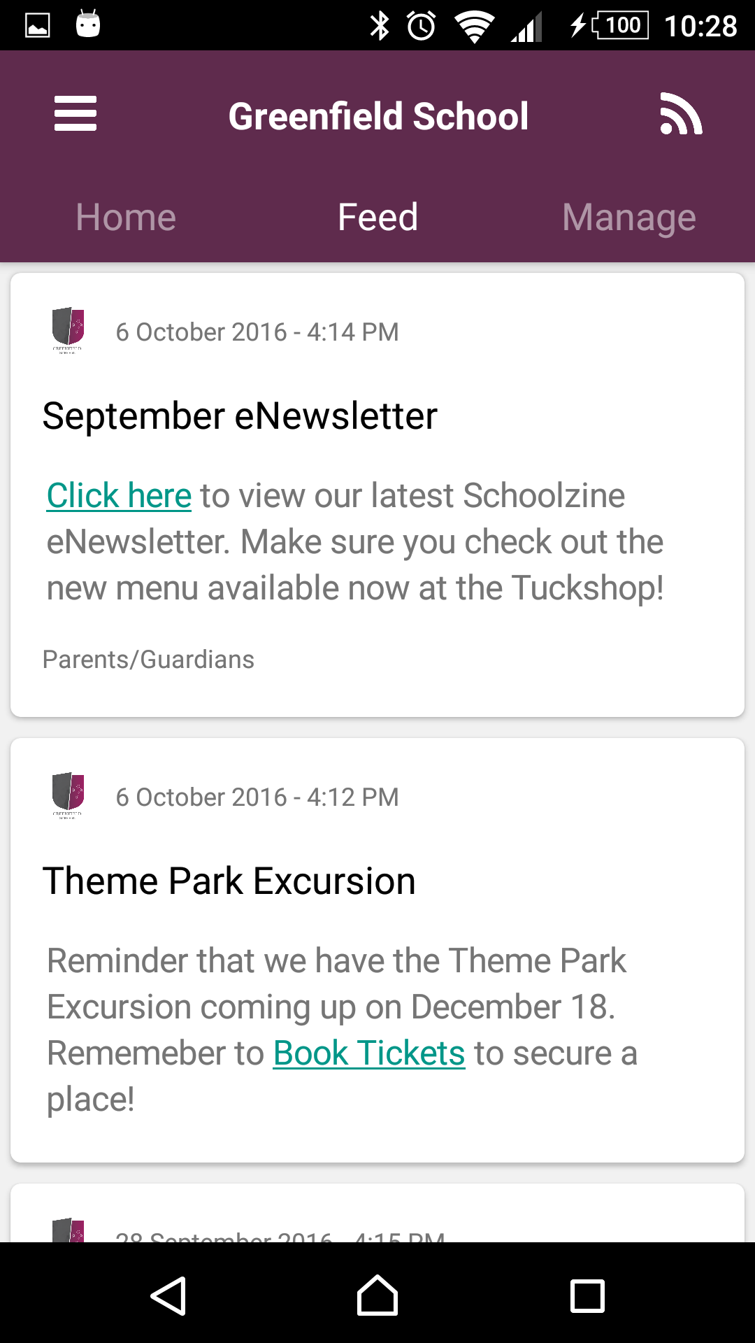
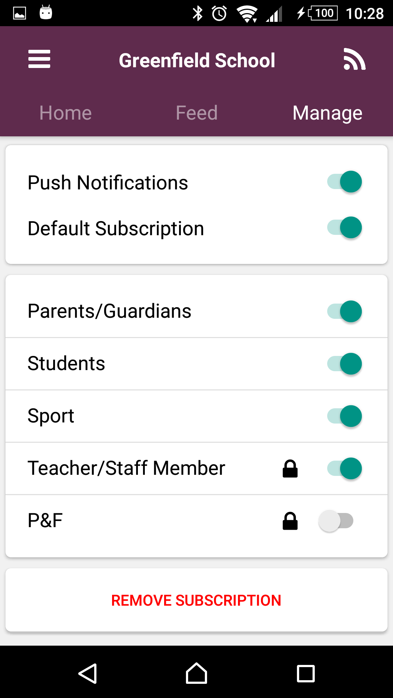
HOME
The Home tab displays the most
recent news item and links to
important school information
and tools.
FEED
The Feed tab shows a summary
view of all news items which
you have subscribed to.
MANAGE
The Manage tab allows you to
customise what information shows
in your news feed and what push
notifications you will receive.

